Slide 1
Testing Software Systems (1)
Tip
Software verification is crucial
in assurance of defect-free systems.

Slide 2
What is Testing
Errors are part of every development and not a criticism of an individual.
Testing is the process of executing a program with the intent of finding an error.
Testing cannot show the absence of errors, it can only show that errors are present.
SET09102 SE3
Unit 3

Slide 3
Testing and debugging
Defect testing and debugging are distinct
processes
Defect testing is concerned with confirming the
presence of errors
Debugging is concerned with locating and
repairing these errors
SET09102 SE3
Unit 3

Slide 4
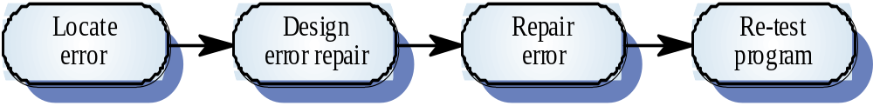
The debugging process
SET09102 SE3
Unit 3

Slide 5
Two basic types of testing
There are two kinds of testing: Defect Testing and Statistical Testing.
In Defect Testing tests are designed to reveal the presence of defects in the system.
In Statistical Testing tests are designed to reflect the frequency of actual user inputs so that after running the tests an estimate of the operational reliability of the system can be made.
SET09102 SE3
Unit 3

Slide 6
Two basic types of testing
Statistical Testing is the area of Software Reliability. In this module, we will focus on Defect Testing.
SET09102 SE3
Unit 3

Slide 7
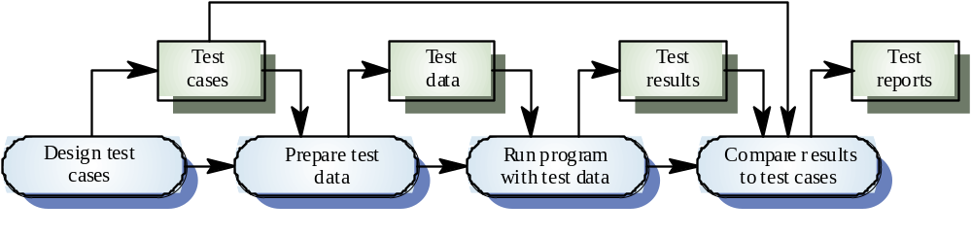
The defect testing process
SET09102 SE3
Unit 3

Slide 8
Inspections and testing
Software inspections Concerned with analysis of
the static system representation to discover problems (static verification)
  May be supplement by tool-based document and code analysis.
Software testing Concerned with exercising and
observing product behaviour (dynamic verification)
  The system is executed with test data and its operational behaviour is observed.

Slide 9

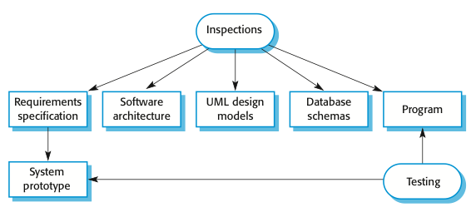
Inspections and testing

Slide 10
Software inspections
These involve people examining the source representation with the aim of discovering anomalies and defects.
Inspections not require execution of a system so may be used before implementation.
They may be applied to any representation of the system (requirements, design, configuration data, test data, etc.).
They have been shown to be an effective technique for discovering program errors.

Slide 11
Advantages of inspections
During testing, errors can mask (hide) other errors. Because inspection is a static process, you don’t have to be concerned with interactions between errors.
Incomplete versions of a system can be inspected without additional costs. If a program is incomplete, then you need to develop specialized test harnesses to test the parts that are available.
As well as searching for program defects, an inspection can also consider broader quality attributes of a program, such as compliance with standards, portability and maintainability.

Slide 12
Inspections and testing
Inspections and testing are complementary and not opposing verification techniques.
Both should be used during the V & V process.
Inspections can check conformance with a specification but not conformance with the customer’s real requirements.
Inspections cannot check non-functional characteristics such as performance, usability, etc.

Slide 13
Testing objectives and test cases
Each test case will have a description of the objective of the test, the input test data needed to conduct the test and a description of the expected result.
The objective of testing is to design test cases that have the highest likelihood of finding the most errors with the minimum amount of time and effort.
SET09102 SE3
Unit 3

Slide 14
Testing objectives and test cases
A good test case has a high probability of finding undiscovered errors.
A successful test is the one which reveals an undiscovered error.
SET09102 SE3
Unit 3

Slide 15
Testing principles
All tests should be traceable to customer requirements
Test should be planned long before testing begins
Exhaustive testing is not possible
To be most effective, system testing should be conducted by an independent third party
SET09102 SE3
Unit 3

Slide 16
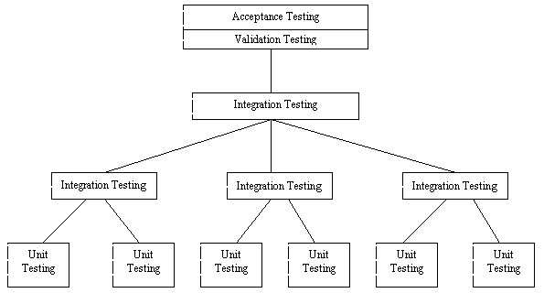
Testing Levels
SET09102 SE3
Unit 3

Slide 17
Unit Testing
Testing each module individually, assuring that it functions properly as a unit.
Unit testing intends to find bugs in logic, data and algorithm in individual modules.
SET09102 SE3
Unit 3

Slide 18
Integration Testing
Modules are integrated often as sub-systems to form the complete software package.
Integration testing intends to find bugs in interfaces between modules.
SET09102 SE3
Unit 3

Slide 19
Validation Testing
This is often referred as System Testing as well. It intends to assure that the software meets all functional and performance requirements.
SET09102 SE3
Unit 3

Slide 20
Acceptance Testing
It determines whether software meets customer requirements.
It can be viewed as an additional level of System Testing.
SET09102 SE3
Unit 3

Slide 21
Regression Testing
As part of validation testing, regression testing is performed to determine if the software still meets its requirements in light of changes to the software.
SET09102 SE3
Unit 3

Slide 22
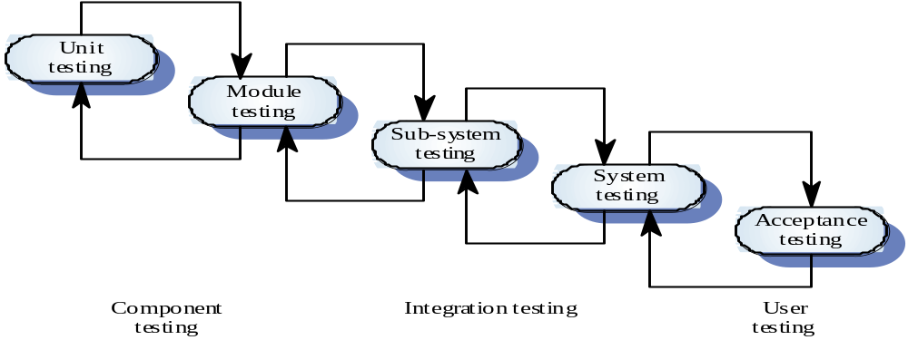
Typical testing process
SET09102 SE3
Unit 3

Slide 23
Testing of newly developed components
Firstly focus on unit testing
And then on integration testing if the component comprises a number of sub-components or units
At final stage, system testing should be conducted on the component as a whole system.
SET11109 EC
Unit 3

Slide 24
Testing of component-based software systems
Focus on integration testing between components
Then, focus on system testing
Ignore the testing of components already been reused in other applications
SET11109 EC
Unit 6

Slide 25
Test Methods
White box testing: a method of testing in which knowledge of the software’s internal design is used to develop tests. Also called as structural testing or glass box testing.
Black box testing: no knowledge of software design is used, and tests are based strictly on requirements and functionality. Also called as functional testing.
'Big Bang' or non-incremental integration
Incremental integration, which can be Top-Down or Bottom-Up
SET09102 SE3
Unit 3

Slide 26
General suggestions
Regardless of the strategy adopted, the testing team should identify critical modules, i.e., addresses severe requirements, high-level of control, complex structure, definite performance requirements
In practice many projects take into account the need to utilize resources as effectively as possible and so often combine the top-down strategy with the bottom-up. Often the overall system is built top-down whereas individual sub-systems may be built bottom-up.
SET09102 SE3
Unit 3

Slide 27
Incremental Testing
In this method, components being tested are added to the test sequence in a stepwise incremental manner.
SET09102 SE3
Unit 3

Slide 28
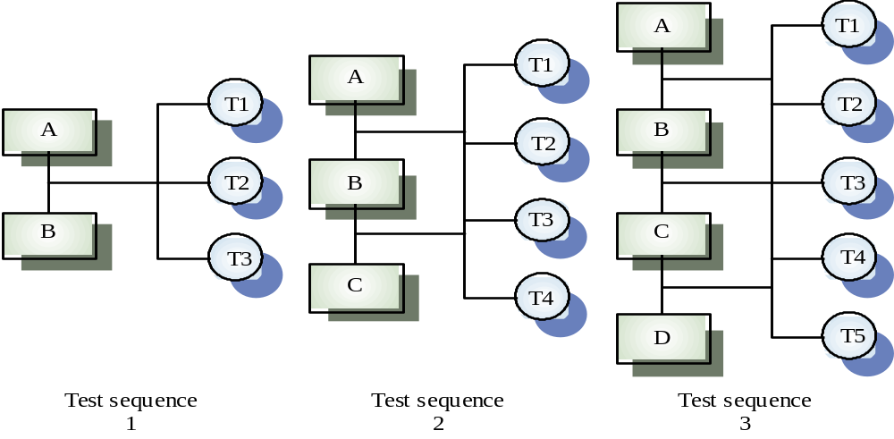
Incremental Testing
SET09102 SE3
Unit 3

Slide 29
Whitebox testing
Applied at the unit testing stage
Needs understanding of the structure and logic of the unit being tested
SET09102 SE3
Unit 3

Slide 30
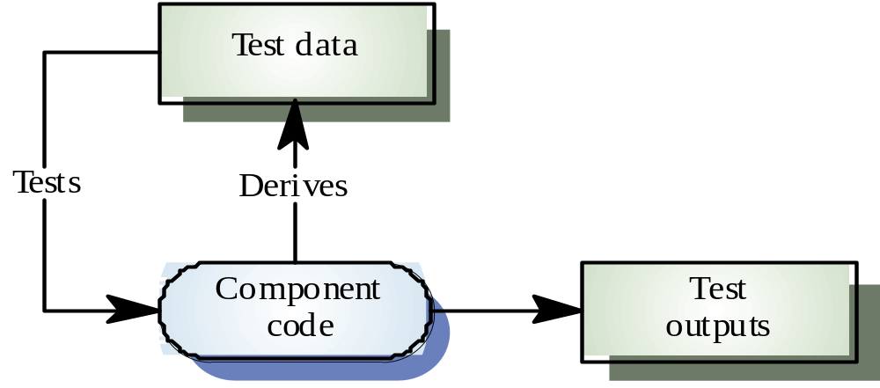
Whitebox testing
SET09102 SE3
Unit 3

Slide 31
Blackbox testing
Applied at the integration testing stage of a testing process
Approach to testing where the program is considered as a `black-box’
The program test cases are based on the system specification
The focus is consistent interfacing
SET09102 SE3
Unit 3

Slide 32
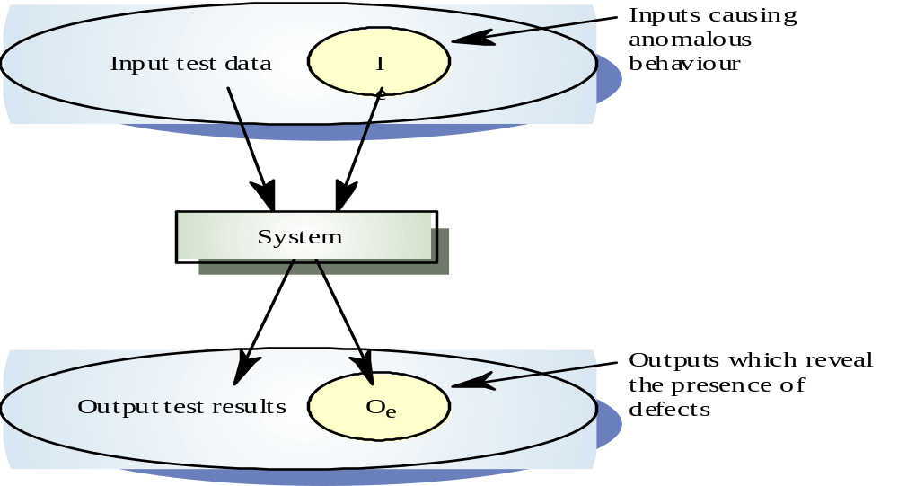
Blackbox testing
SET09102 SE3
Unit 3

Slide 33
Top-Down Integration testing
Modules are integrated by moving downward through the control hierarchy beginning with the main control module.
When the main control module has been tested it is used as a Test Driver
And Test Stubs of subordinate modules are replaced once at a time with actual modules.
This can be done in a depth-first or breadth-first manner.
SET09102 SE3
Unit 3

Slide 34
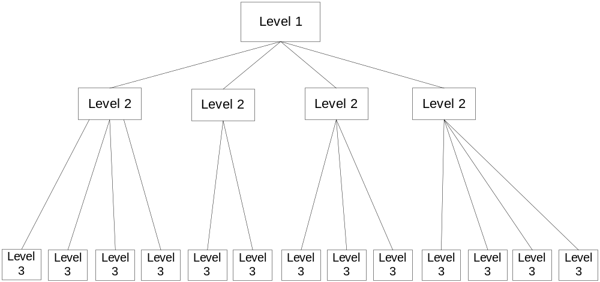
Software Control Hierarchy
SET09102 SE3
Unit 3

Slide 35
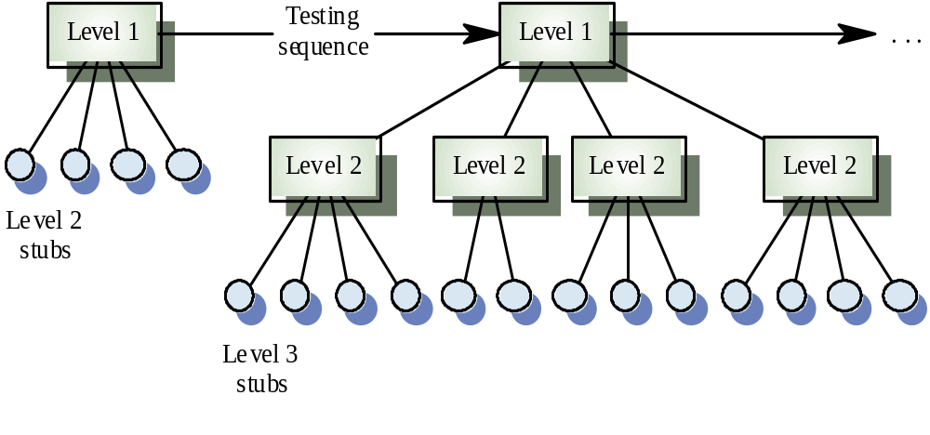
Top-Down Integration testing
Tests are conducted as each module is integrated.
SET09102 SE3
Unit 3

Slide 36
Test Harness and Test Stub
A Test Harness (Test Driver) is a program that accepts test case data, passes this to the module under test, collects the outputs from the tested module and prints (or records) these results.
If the tested module calls another module, this module is replaced by a Stub, which has the same interface as the replaced module but which returns a known (or controlled) result.
SET09102 SE3
Unit 3

Slide 37
Test Harness and Test Stub
Both Test Harnesses and Stubs represent an overhead - extra software that must be written but which is generally not deliverable.
A sample test stub:
  Double calculate-totalvalueof-properties(String name)
  {
  return 100500
  }
The real module may contain hundreds of lines of code to calculate the value of the customer’s every house, bank saving, shares, loans, etc.
SET09102 SE3
Unit 3

Slide 38
Advantage of Top-Down Integration testing
Verifies major control or decision points early in the test process.
A depth-first approach sometimes has the advantage that a complete path of functionality can be tested and demonstrated. I.e., testing a complete sub-system first. E.g., using cheques in a banking system.
SET09102 SE3
Unit 3

Slide 39
Advantage of Top-Down Integration testing
Banking
Cheque
Card
Counter
Require a
cheque book
Payment
by cheque
Cancel
a cheque
SET09102 SE3
Unit 3

Slide 40
Disadvantage of Top-Down Integration testing
Often the lower level modules are the ones which acquire data and then pass it up to the higher level modules. While stubs are still in place, no significant data can pass upwards and so the tester is left with two choices:
  delay test until stubs replaced, for pure top-down integration testing, this is impossible.
SET09102 SE3
Unit 3

Slide 41
Disadvantage of Top-Down Integration testing
  develop stubs with restricted functionality of actual module, but care is needed because extra effort is required to construct them and they can all too easily become too complex and swallow up resources.
SET09102 SE3
Unit 3

Slide 42
Bottom-Up Integration Testing
Testing begins at the lowest level of the program structure and works upward.
Low-level modules are combined into clusters that perform a specific software function.
A Test Harness is written to coordinate input and output.
The cluster is tested and then the Harness is removed and clusters are combined.
SET09102 SE3
Unit 3

Slide 43
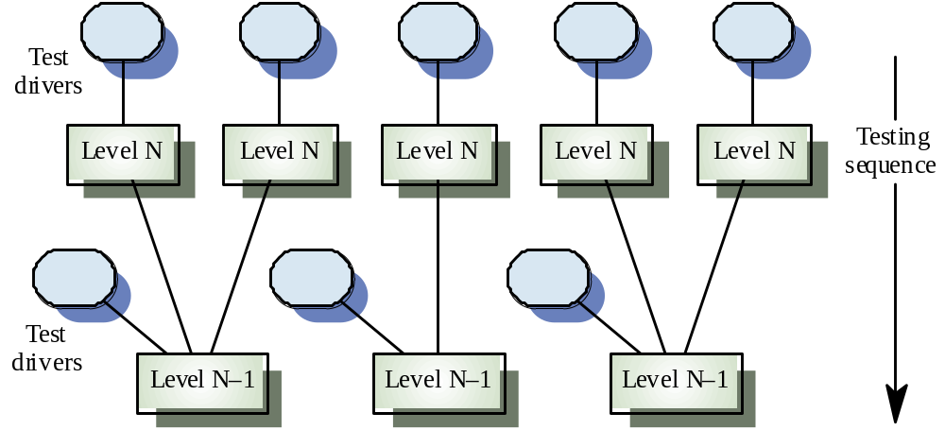
Bottom-Up Integration Testing
SET09102 SE3
Unit 3

Slide 44
Advantage of Bottom-Up Integration Testing
stubs are not required
easier test case design
SET09102 SE3
Unit 3

Slide 45
Disadvantage of Bottom-Up Integration Testing
Program does not exists until all modules are integrated
Needs test drivers
SET09102 SE3
Unit 3

Slide 46
Typical methods for different testing levels
Unit testing----White box
Integration testing----Black box, top-down, bottom-up
Validation testing----Black box
SET09102 SE3
Unit 3

Slide 47
Object-oriented system testing
Less closely coupled systems. Objects are not necessarily integrated into sub-systems
Cluster testing. Test a group of cooperating objects
Thread testing. Test a processing thread as it weaves from object to object.
SET09102 SE3
Unit 3

Slide 48
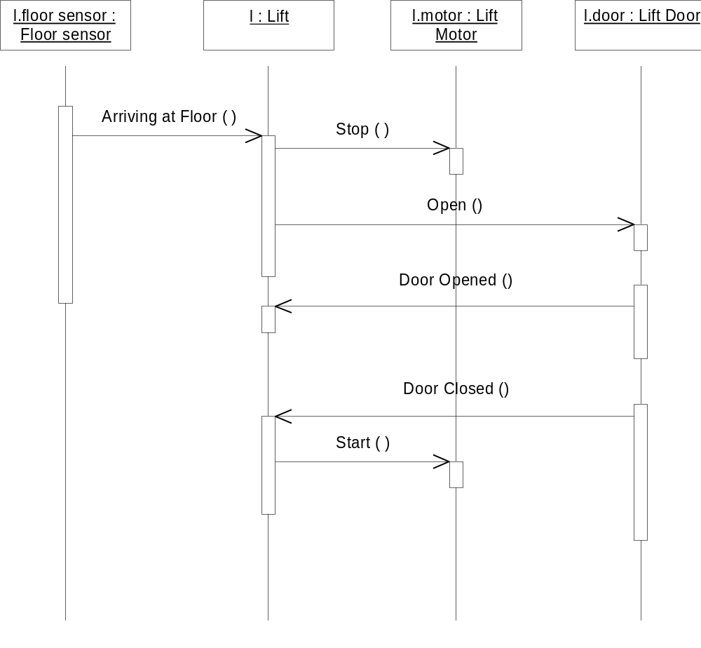
A cluster of cooperating objects—a lift visits a floor
SET09102 SE3
Unit 3

Slide 49
Thread testing
Suitable for real-time and object-oriented systems
Based on testing an operation which involves a sequence of processing steps which thread their way through the system
Start with single event threads then go on to multiple event threads
Complete thread testing is impossible because of the large number of event combinations
SET09102 SE3
Unit 3

Slide 50
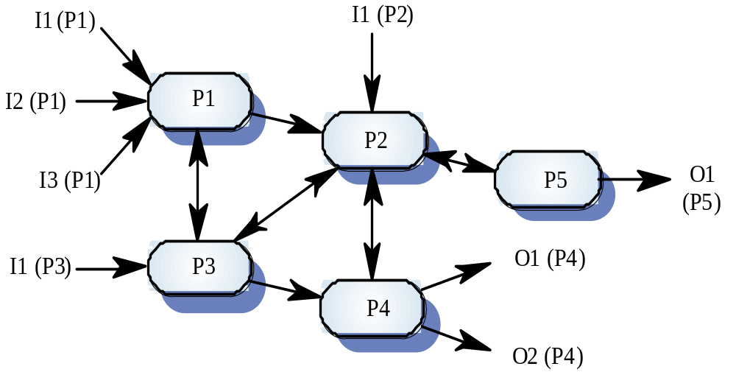
An Example of Multiple Thread Testing
SET09102 SE3
Unit 3

Slide 51
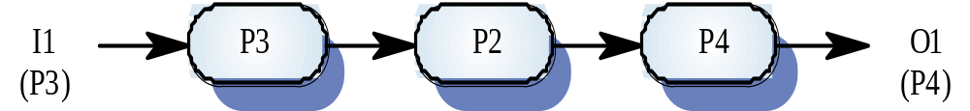
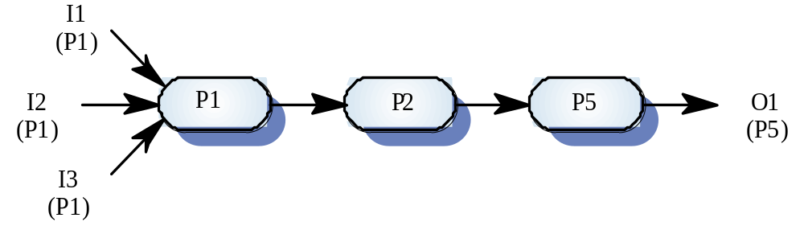
Possible Thread Testing
SET09102 SE3
Unit 3

Slide 52
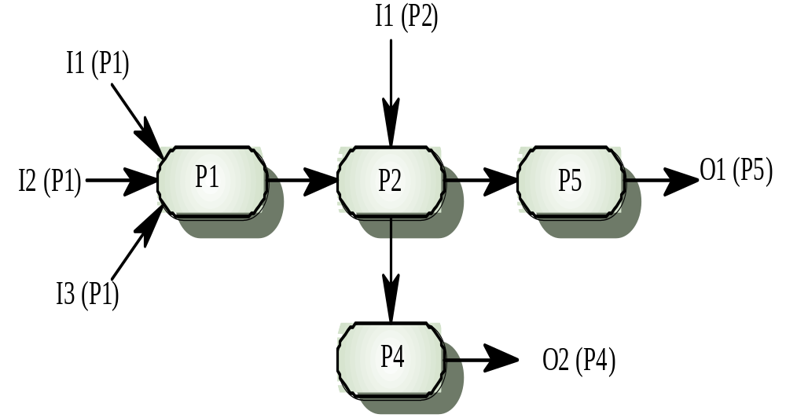
Multiple Thread Testing
SET09102 SE3
Unit 3

Slide 53
Stress testing
Exercises the system beyond its maximum design load. Stressing the system often causes defects to come to light
Stressing the system to test failure behaviour. Systems should not fail catastrophically. Stress testing checks for unacceptable loss of service or data
Particularly relevant to distributed systems which can exhibit severe degradation as a network becomes overloaded
SET09102 SE3
Unit 3

Slide 54
Back-to-back testing
Present the same tests to different versions of the system and compare outputs. Differing outputs imply potential problems
To reduce the costs of examining test results, automatic comparison of outputs may be done.
Possible when a prototype is available or with regression testing of a new system version
SET09102 SE3
Unit 3

Slide 55
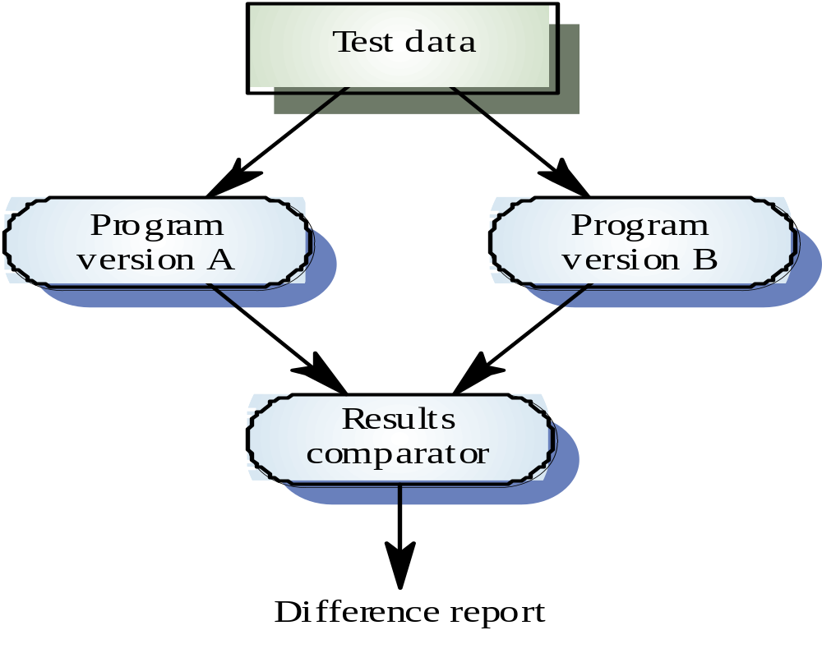
Back-to-back testing
SET09102 SE3
Unit 3

Slide 56
Performance testing
Part of release testing may involve testing the emergent properties of a system, such as performance and reliability.
Tests should reflect the profile of use of the system.
Performance tests usually involve planning a series of tests where the load is steadily increased until the system performance becomes unacceptable.
Stress testing is a form of performance testing where the system is deliberately overloaded to test its failure behaviour.

